Slide 1


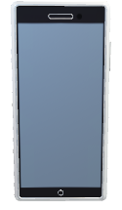





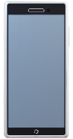
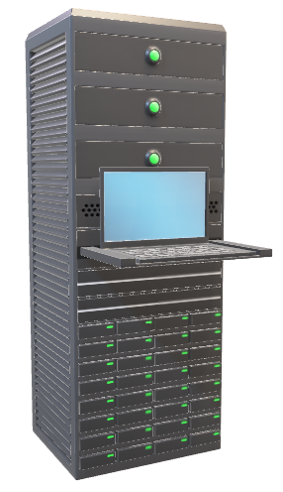


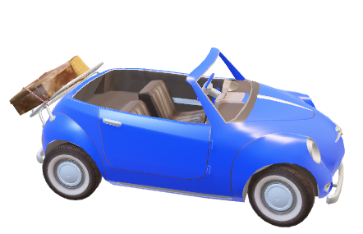

Server
Web Admin
위험 알림
FCM
Client Tablet
Client
Mobile
Car
Can 통신

Slide 2
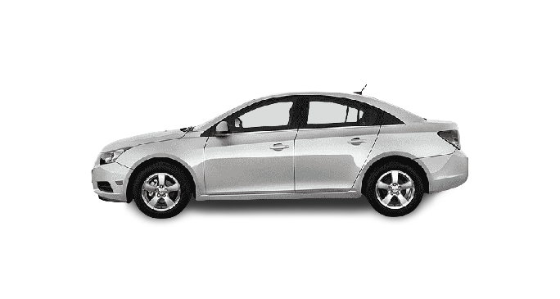
Admin Web Browser
AWS
Server
Oracle
Database
Sensor,
ECU
can
can
IoT Client
Linux
FCM
Hadoop
Hive
Client
Tablet
Client
Mobile

Slide 3
Admin Web Browser
TCP/IP
AWS
R
R Studio
Tomcat, TCP/IP Server
MyBatis
SQL
HTTP
Oracle
Database
MariaDB
Sensor
ECU
can
can
IoT Client
Linux
Firebase
FCM
Hadoop
Hive
TCP/IP
Client
Android
Tablet
HTTP
TCP/IP
Client
Android
Mobile

